Slide 1



Contributors:
Abhidha Arya
Neha Chaudhary
Philadelphia Crime Analysis

Slide 2
AGENDA
ABOUT PHILADELPHIA CRIME RATE
OBJECTIVE
PROJECT GOALS
DATA DESCRIPTION
PRE-PROCESSING TECHNIQUES
CLASSIFICATION TECHNIQUES
MODEL COMPARISION
BUSINESS VALUE

Slide 3
PHILADELPHIA CRIME RATE
Philadelphia is amongst the top five cities in USA with most violent crimes.
10% increase in the Violent crime offenses from 2014 to 2015.
Gun violence and homicides significantly higher than the previous year.
Violent offenses tracked included rape, murder and non-negligent manslaughter, armed robbery, and aggravated assault, including assault with a deadly weapon.
According to the analysis of FBI reported crime data, your chance of becoming a victim of one of these crimes in Philadelphia is one in 98.

Slide 4
OBJECTIVE
Mine Philadelphia’s Crime Data.
Use SAS Enterprise Miner
To understand patterns in crime.
To identify important factors causing the type of crime to be committed in a particular area.
Analyze the factors which predicts whether Violent or Non-Violent crime is most likely to occur given a month, place and socio-demographics in Philadelphia.

Slide 5
PROJECT GOALS
To identify the attributes in the data which could predict the type of crime committed.
The attributes could be details related to:
Location
Time of the year
Demographics
To propose a business solution to mitigate crime and increase police patrolling in specific zones.

Slide 6
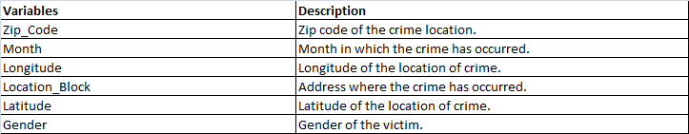
DATA DESCRIPTION
Philadelphia crime data is a second hand data obtained from an online source Kaggle.com
Contains data related to different types of committed crimes according to geographic location and socio demographics.
There are totally 23 variables with 46,783 observations.
Target variable is ‘Violent’.

Slide 7
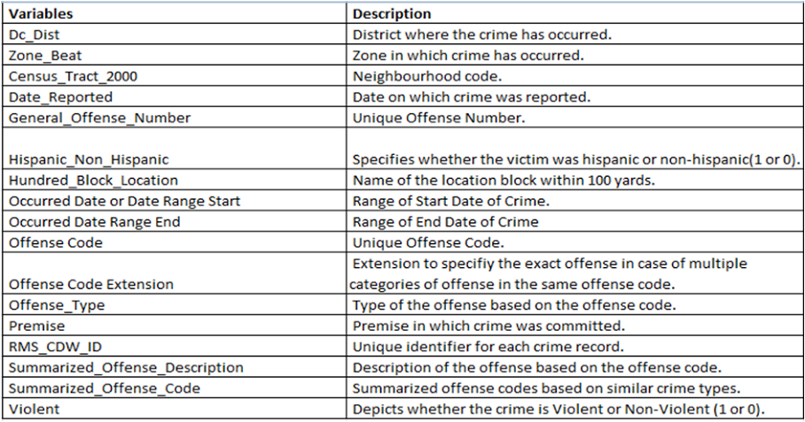
DATA DESCRIPTION CONT’D

Slide 8
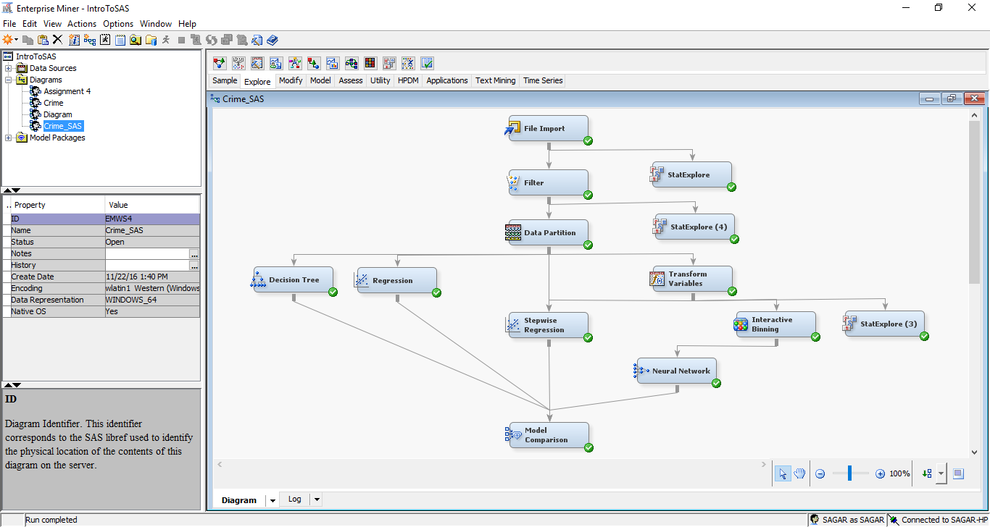
SAS MODEL

Slide 9
FILE IMPORT
File Import node is used to import the data so that SAS Enterprise Miner can interpret the dataset.
Data is imported in SAS Enterprise Miner in the form of a .csv file.
The target variable is assigned and irrelevant variables are rejected.
Variables are rejected due to below reasons-
Direct Co-relation with the output.
Insignificant Variables

Slide 10
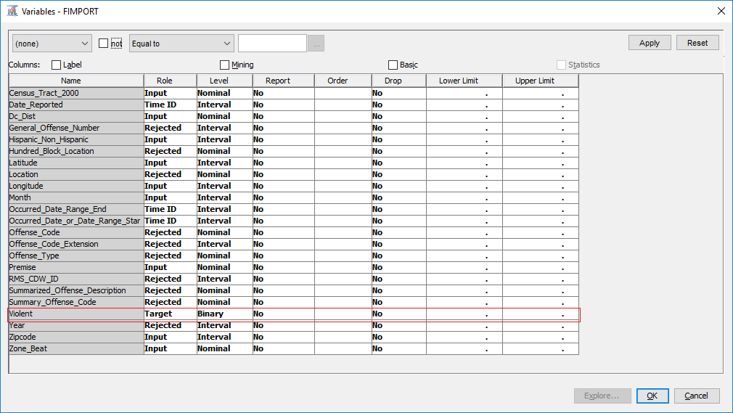
FILE IMPORT CONT’D

Slide 11
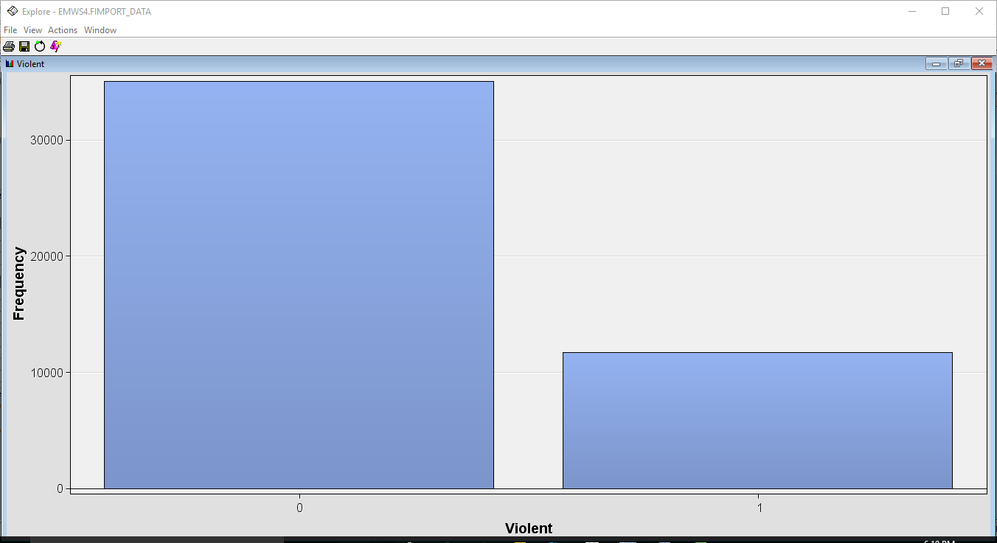
TARGET VARIABLE
Target Variable – ‘Violent’
The target Variable is Binary
0 – Non- Violent
1- Violent
25% (11,697) of the observation is under Violent category and the rest 75% (35,086) is Non Violent out of a total of 46,783 observations.

Slide 12
DATA PRE-PROCESSING
Stat Explore node is used to analyze the variable statistics.
It shows the relevance of input variables to the target variable “Violent”.
Some missing values are observed in the data set as shown by the stat explore node.

Slide 13
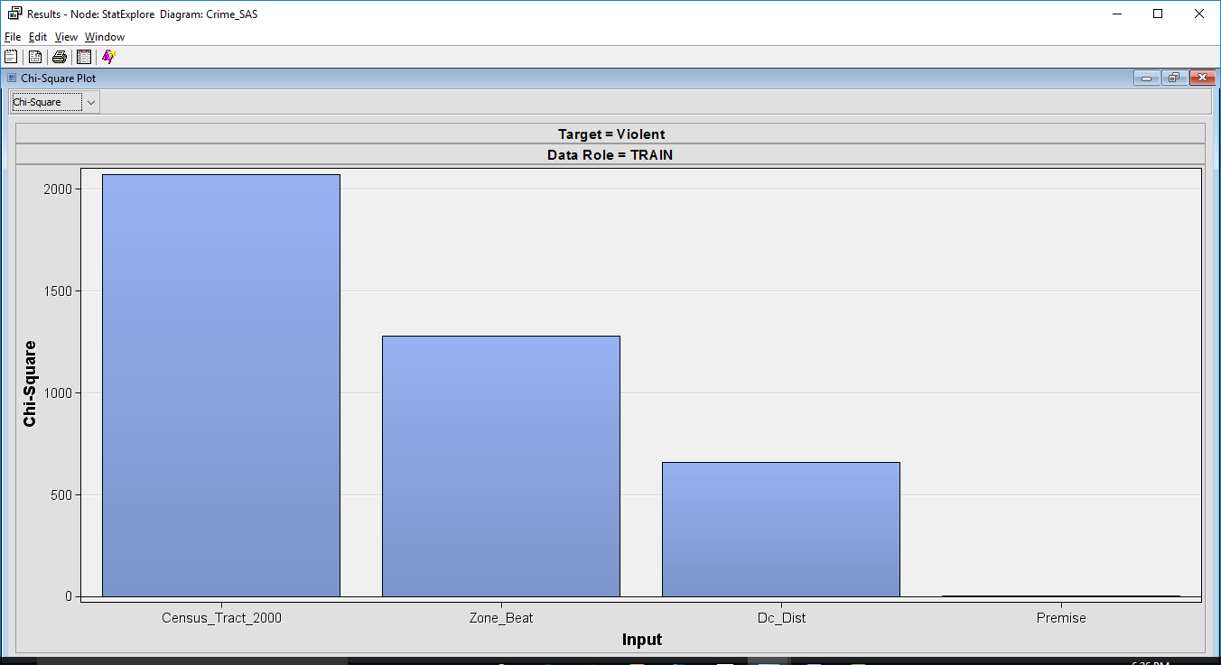
DATA PRE-PROCESSING CONT’D

Slide 14
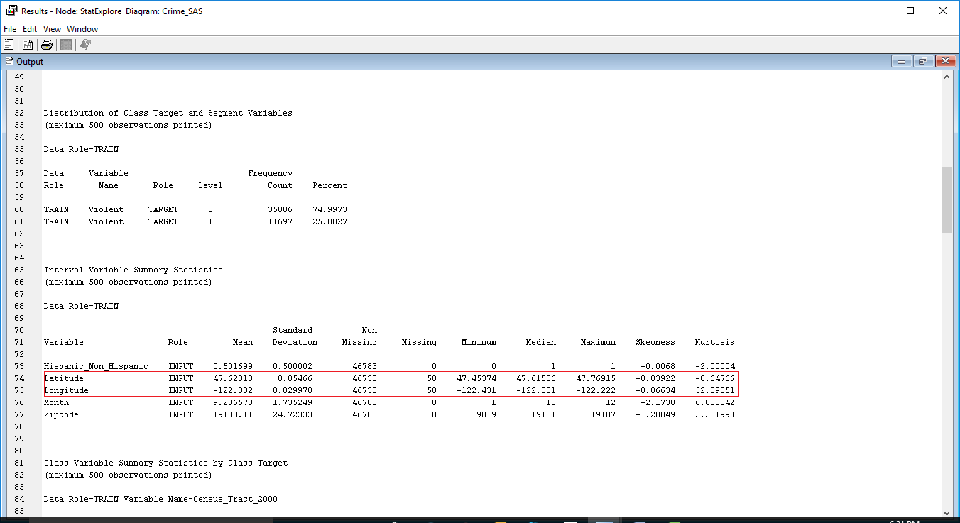
DATA PRE-PROCESSING CONT’D

Slide 15
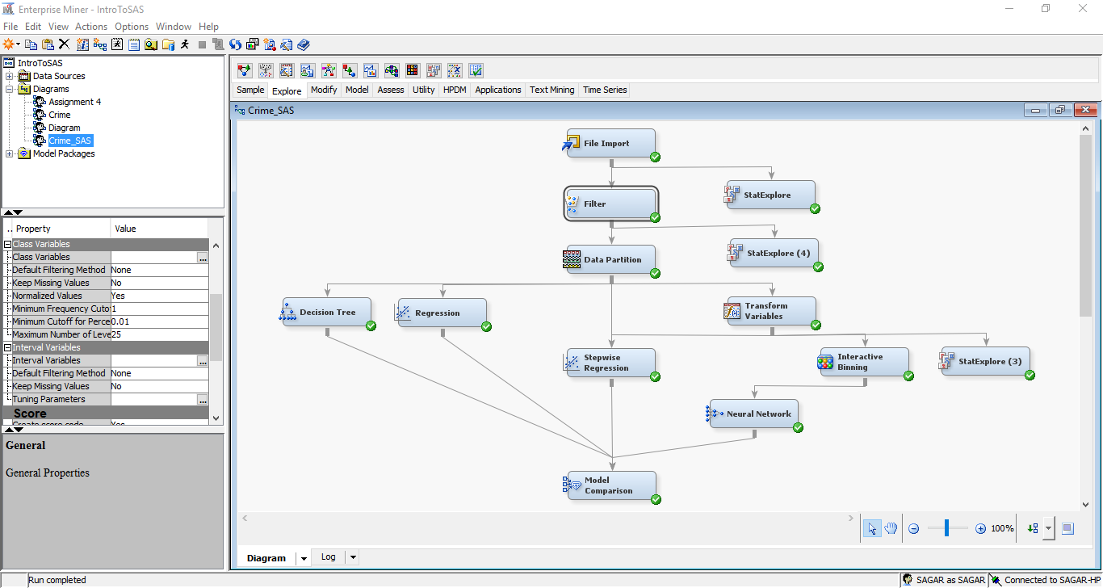
FILTER NODE
Filter node excluded the missing values from the dataset. The default filtering method was kept as none and the property of filter node Keep Missing Values was kept as No.

Slide 16
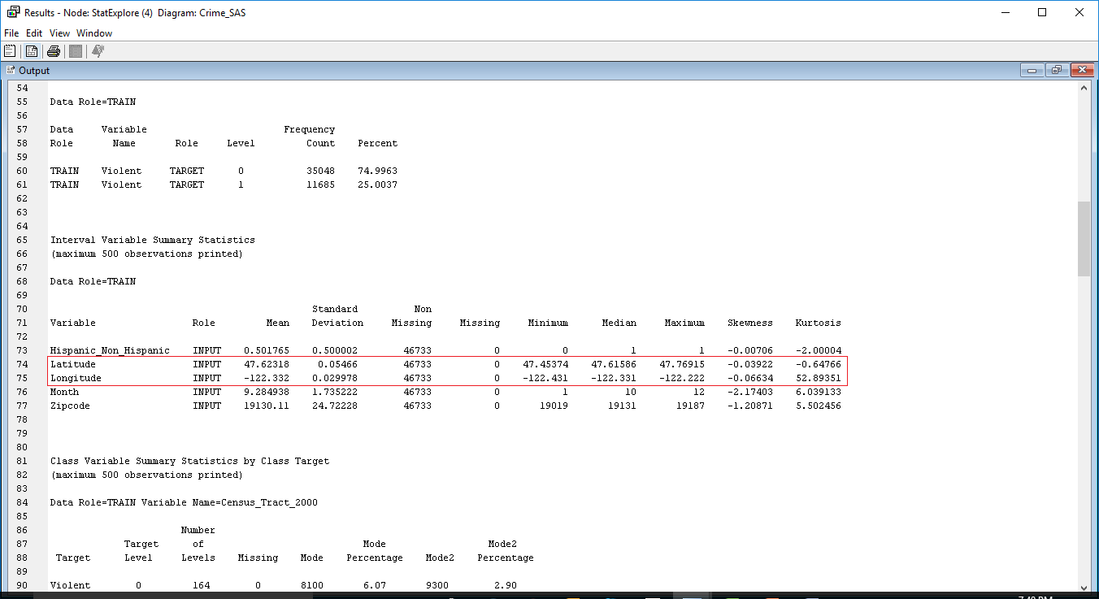
FILTER NODE CONT’D
Stat explorer node is added again to check whether the missing values has have been removed.

Slide 17
TRANSFORM VARIABLES
Transform variable is used as a part of data preprocessing to reduce the skewness of the input variables.
Transformation method has been set as ‘Log’ for transforming the variables of the dataset.

Slide 18
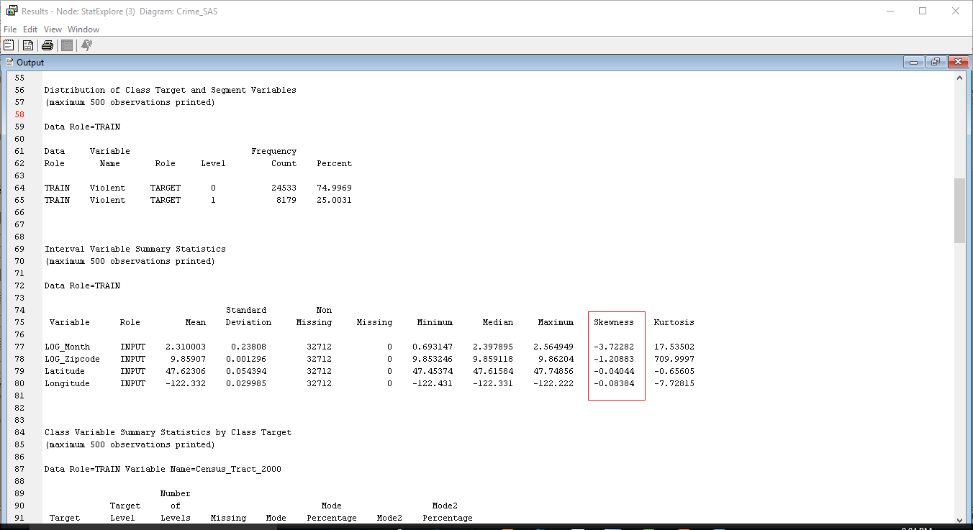
TRANSFORM VARIABLES CONT’D

Slide 19
DATA PARTITIONING
Data partition node is applied to partition data into Training, Validation and Testing in order to build prediction model.
Type | Percentage of Data | No of Observations
Data | 100% | 46783
Train | 70% | 32746
Validate | 20% | 9356
Test | 10% | 4681

Slide 20
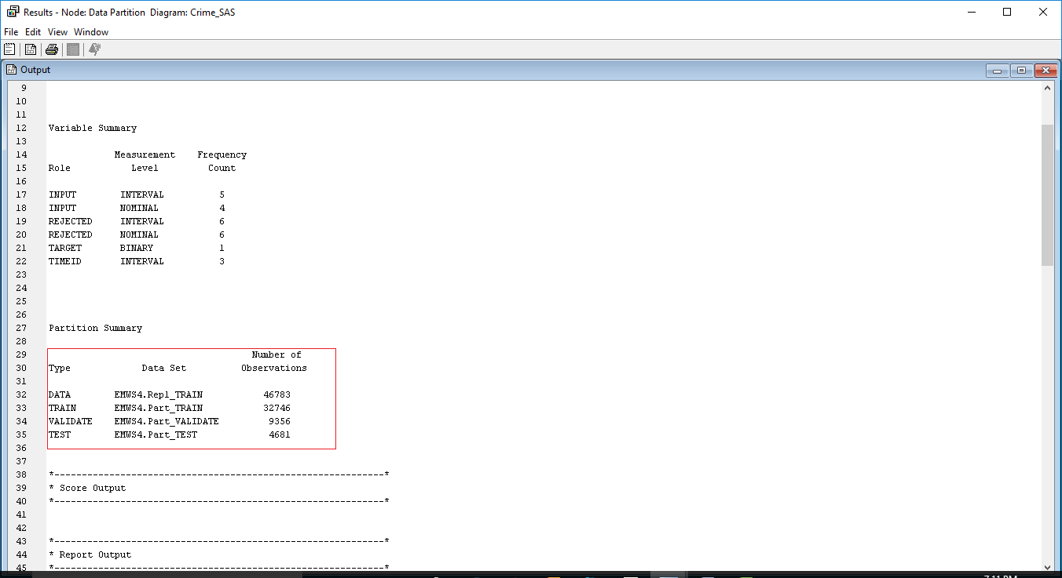
DATA PARTITIONING CONT’D

Slide 21
PREDICTIVE MODELLING TECHNIQUES
We have used the following Predictive Modelling Techniques :
Logistic Regression
Decision trees
Stepwise Regression with Transform Variable
Neural Networks

Slide 22
LOGISTIC REGRESSION
Performed the Regression analysis on the dataset to find significant variables which drive the target variable Violent.
As the target variable is binary - Violent or Non-Violent crime, we have used the Logistic Regression to predict whether the crime will be violent or non-violent from the new set of data.

Slide 23
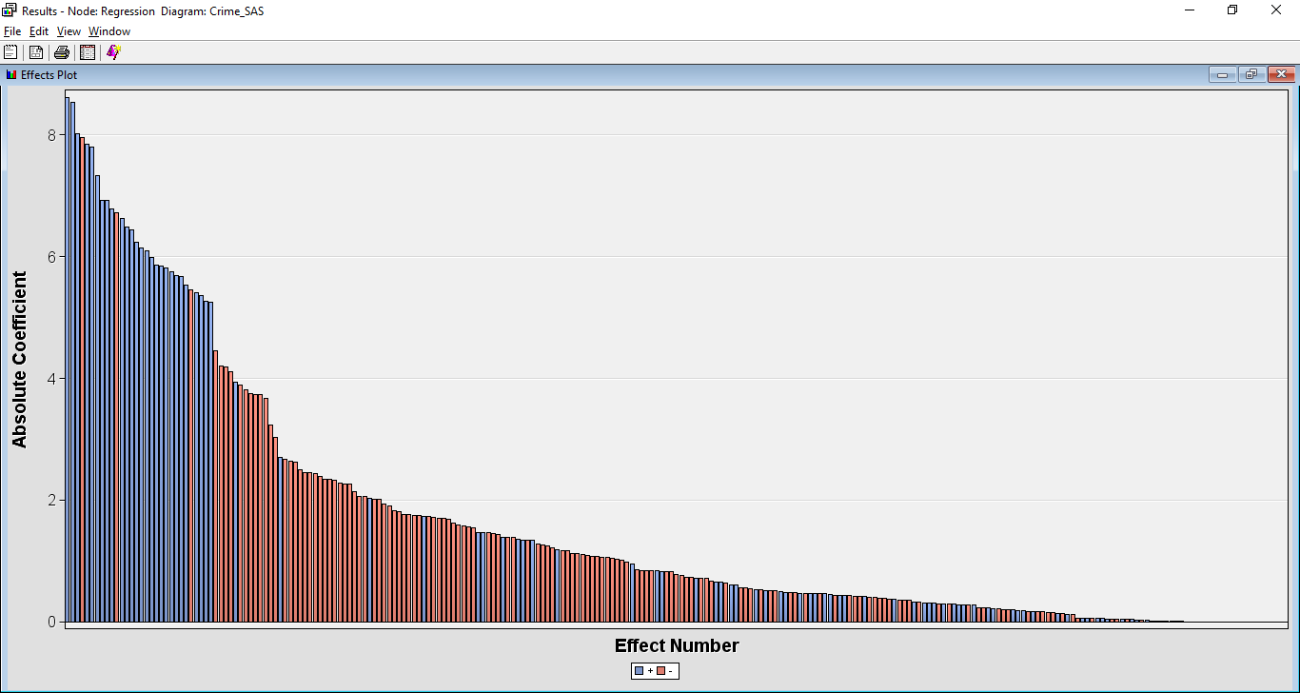
LOGISTIC REGRESSION OUTPUT
EFFECTS PLOT
From the effects plot window we can see that greater the absolute coefficient value, the more important that variable is to the regression model.
In the data set most important variables and thus significant predictor variables are Census_Tract_2000, Zone_Beat, Month, Longitude, Latitude, Dc_Dist.

Slide 24
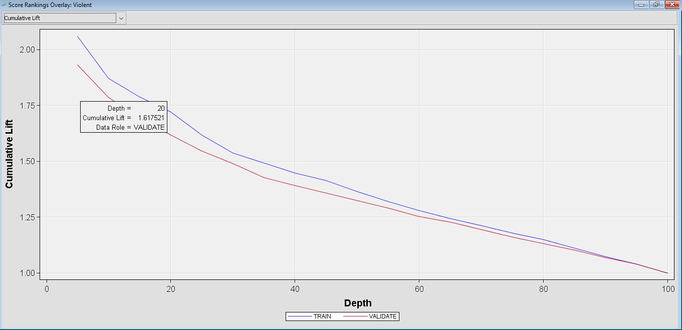
LOGISTIC REGRESSION OUTPUT
CUMULATIVE LIFT
Lift is the improvement obtained by modelling i.e. the ratio between the result obtained with and without the predictive modelling.
Cumulative Lift value at the top twenty percentile in the validation data for Regression node is 1.617521.

Slide 25
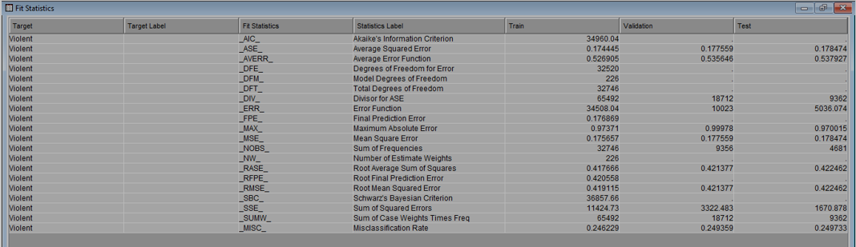
LOGISTIC REGRESSION OUTPUT
FIT STATISTICS
The fit statistics tell us about the accuracy of the model.
Misclassification Rate is the fraction of cases assigned to the wrong class, so lower the value of misclassification rate and better the model.
Low value of Mean square error specifies that the predicted values are very close to the actual values.
The Misclassification Rate in case of Logistic Regression is coming out to be 0.249359
The Mean Square Error is 0.177559

Slide 26
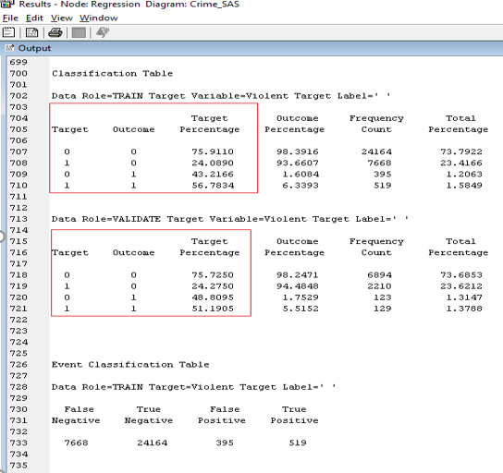
LOGISTIC REGRESSION OUTPUT
CLASSIFICATION TABLE
Based on the result from classification table, regression model is 51.1905% accurate for true positive (target variable= 1, predicted outcome = 1).
And 75.7250% accurate for true negative (target variable =0, predicted outcome =0).

Slide 27
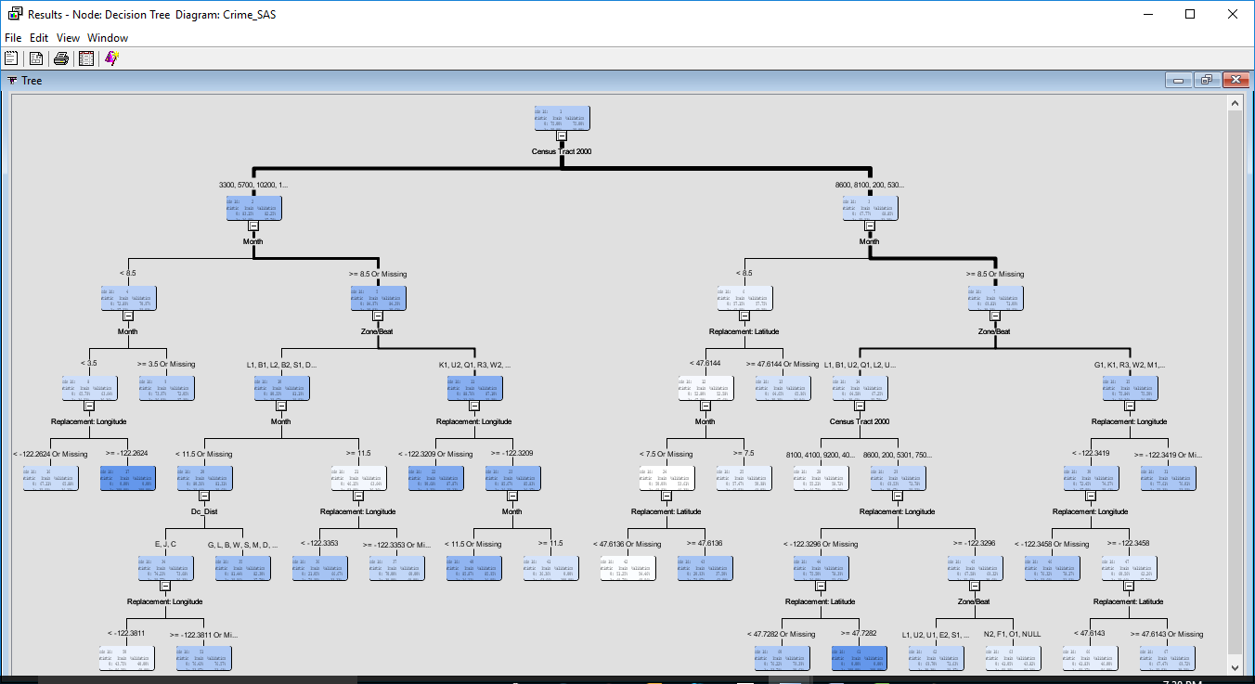
DECISION TREE

Slide 28
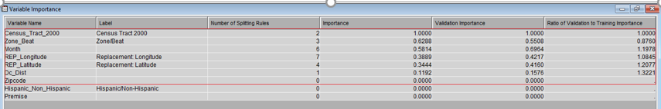
DECISION TREE
VARIABLE IMPORTANCE
The important variables are:
Census_Tract_2000
Zone/Beat, Month
Longitude
Latitude
Dc_Dist.

Slide 29
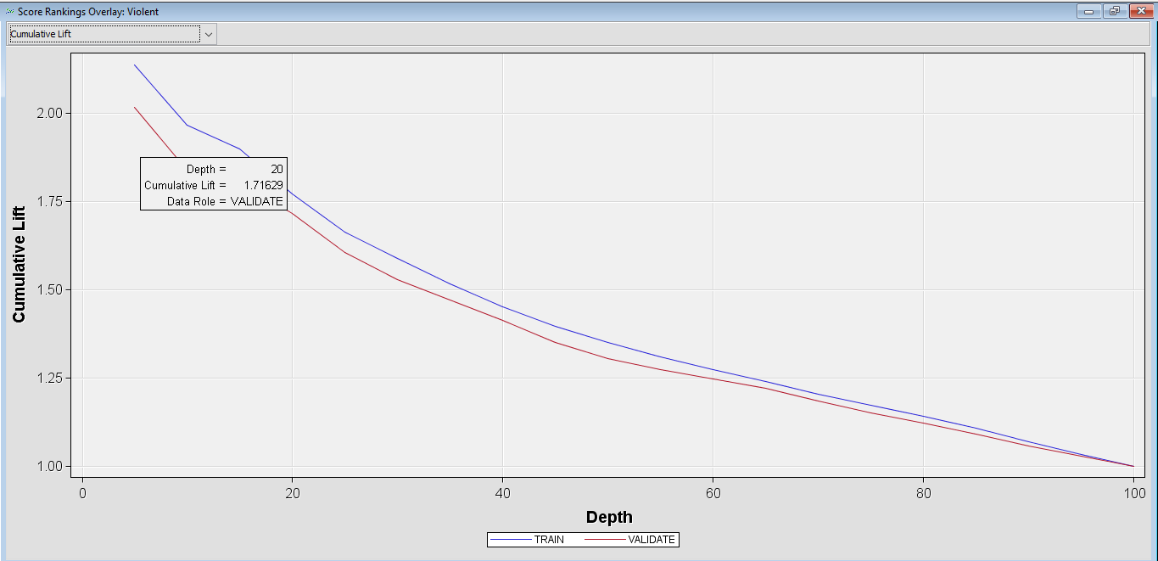
DECISION TREE
CUMULATIVE LIFT
Cumulative Lift value at the top twenty percentile in the validation data for Decision Tree node is 1.71629.

Slide 30
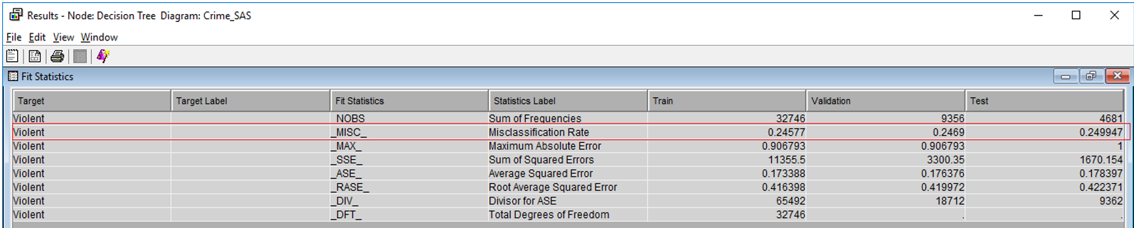
DECISION TREE OUTPUT
FIT STATISTICS
The Misclassification Rate in case of Decision Tree is coming out to be 0.2469.
The Average Square Error is 0.176376.

Slide 31
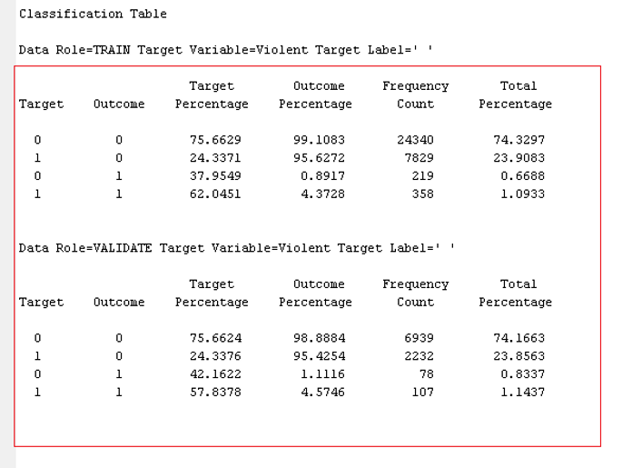
DECISION TREE OUTPUT
CLASSIFICATION TABLE
Based on the result from classification table, decision tree model is 57.8378% accurate for true positive (target variable= 1, predicted outcome = 1).
And 75.6624% accurate for true negative (target variable =0, predicted outcome =0).

Slide 32
STEPWISE REGRESSION
The general idea behind the stepwise regression procedure is that we build our regression model from a set of candidate predictor variables by entering and removing predictors — in a stepwise manner — into our model until there is no justifiable reason to enter or remove any more.

Slide 33
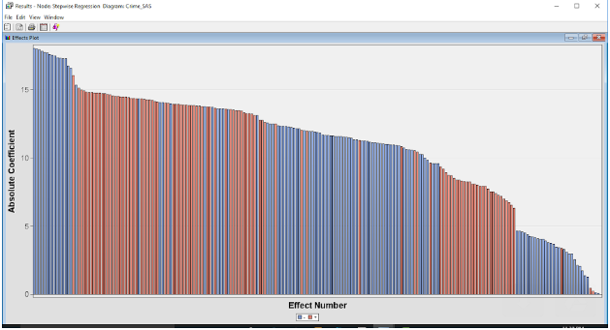
STEPWISE REGRESSION OUTPUT
From the effects plot window we can see greater the absolute value of variable, the more important that variable is to the regression model.
In the data set most important variables and thus significant predictor variables are Census_Tract_2000, Zone_Beat, Month, Longitude, Latitude, Dc_Dist.

Slide 34
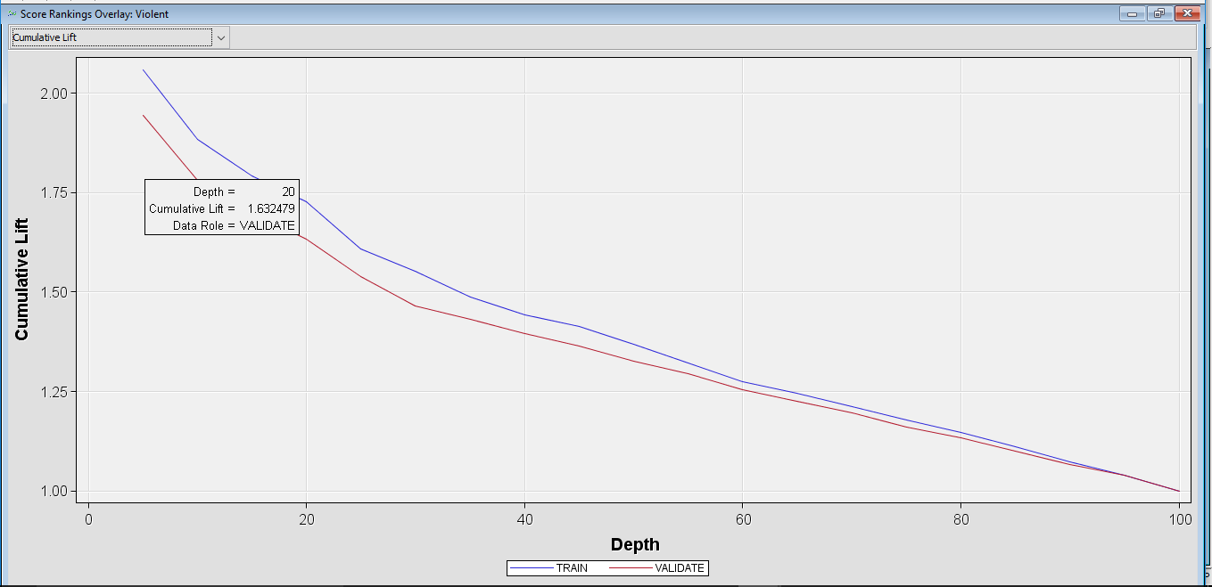
STEPWISE REGRESSION OUTPUT
Lift is the improvement obtained by modelling i.e. the ratio between the result obtained with and without the predictive modelling.
Cumulative Lift value at the top twenty percentile in the validation data for Stepwise Regression node is 1.632479.

Slide 35
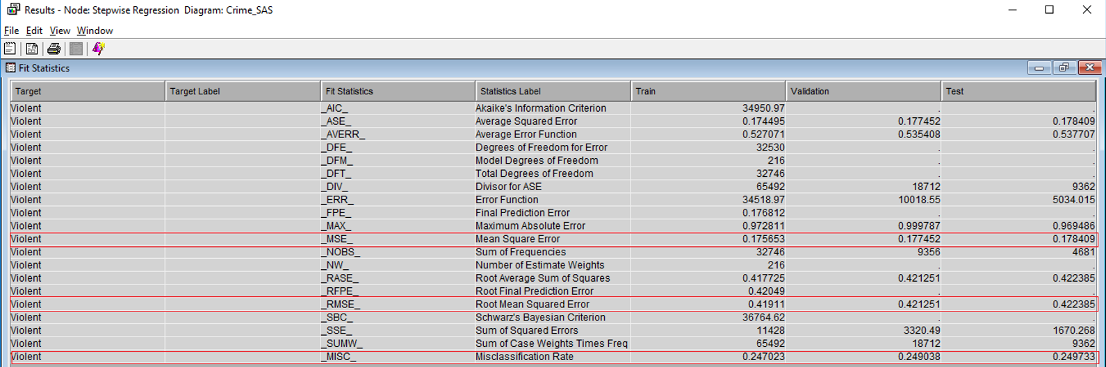
STEPWISE REGRESSION OUTPUT
FIT STATISTICS
The fit statistics tell us about the accuracy of the model.
Misclassification Rate is the fraction of cases assigned to the wrong class, so lower the value of misclassification rate and better the model.
Low value of Mean square error specifies that the predicted values are very close to the actual values.
The Misclassification Rate in case of Stepwise Regression is coming out to be 0.249038.
The Mean Square Error is 0.177452.

Slide 36
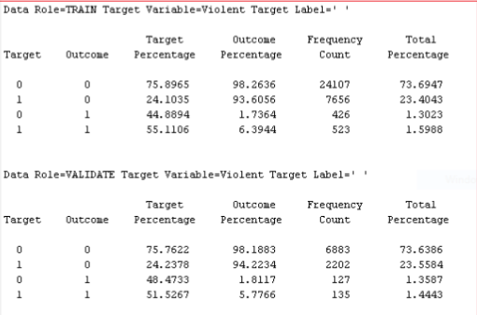
STEPWISE REGRESSION OUTPUT
CLASSIFICATION TABLE
Based on the result from classification table, Step wise regression model is 51.5267% accurate for true positive (target variable= 1, predicted outcome = 1).
And 75.7622% accurate for true negative (target variable =0, predicted outcome =0).
Although True positive rate and True negative rate is higher in stepwise regression as compared to Logistic regression model, but in comparison to Decision tree model that we presented, it is slightly lower.

Slide 37
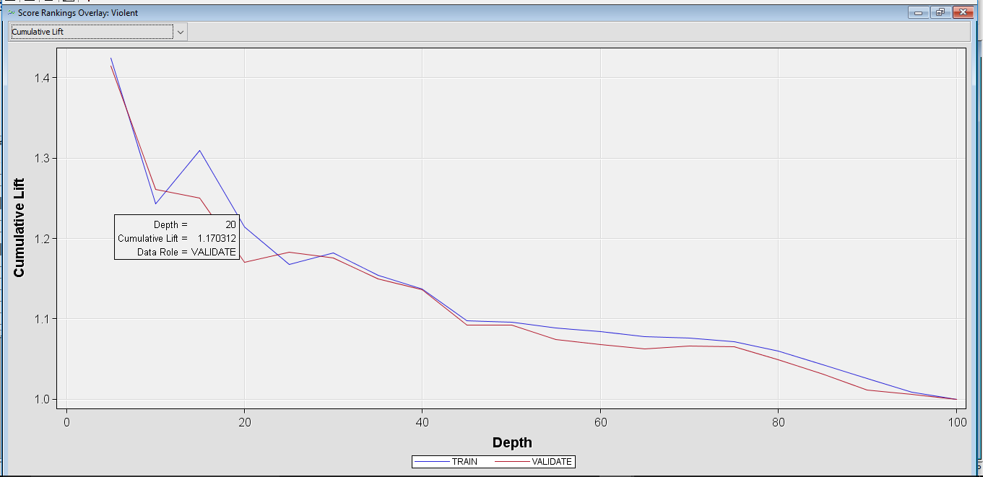
NEURAL NETWORK OUTPUT
CUMULATIVE LIFT
Lift is the improvement obtained by modelling that is the ratio between the result obtained with and without the predictive modelling.
Cumulative Lift value at the top twenty percentile in the validation data for Neural Network node is 1.170312.

Slide 38
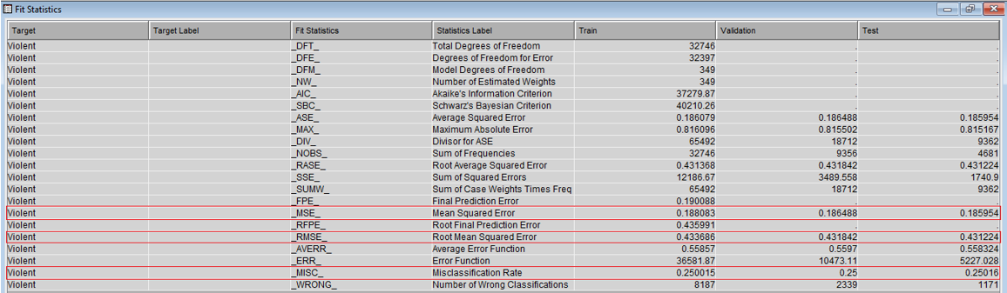
NEURAL NETWORK OUTPUT
FIT STATISTICS
The fit statistics tell us about the accuracy of the model.
Misclassification Rate is the fraction of cases assigned to the wrong class, so lower the value of misclassification rate and better the model.
Low value of Mean square error specifies that the predicted values are very close to the actual values.
The Misclassification Rate in case of Neural Network is coming out to be 0.25.
The Mean Square Error is 0.186488.

Slide 39
MODEL COMPARISON
Model | Misclassification Rate (Valid) | Average Squared Error
Decision Tree | 24.69% | 17.63%
Stepwise Regression | 24.9% | 17.74%
Regression | 24.93% | 17.75%
Neural Network | 25% | 18.64%

Slide 40
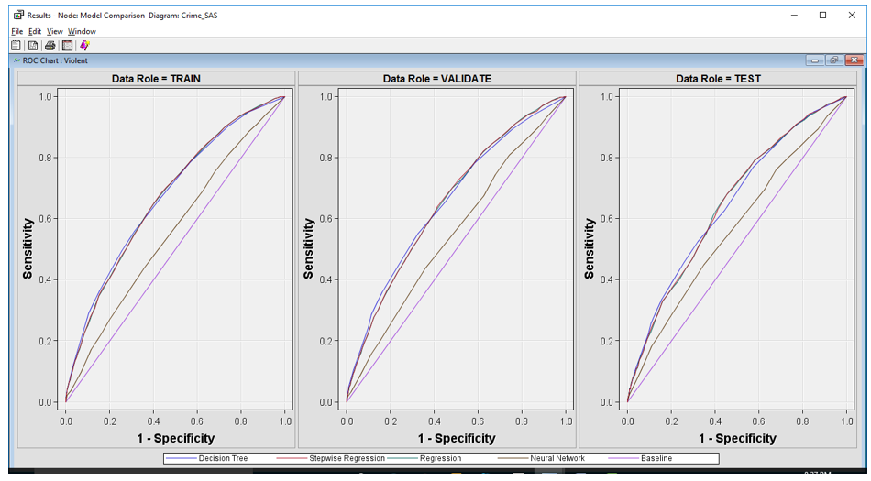
ROC CURVE

Slide 41
SIGNIFICANT VARIABLES
Census_Tract_2000
Zone_Beat
Month
Longitude Positively Correlated
Latitude
Dc_Dist

Slide 42
BUSINESS VALUE- RECOMMENDATIONS
Zone Positively correlated to the type of crime.
Month Positively correlated to the type of crime.
This way Philadelphia Police Department can deploy their resources in a more effective manner and devise solutions to crime problems by formulating crime prevention strategies.

Slide 43

Thank You!
Questions?

